Slide 1
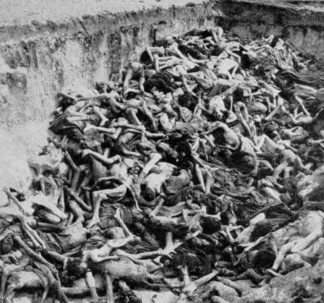
Can These Bones Live?
Ezekiel 37

Slide 2
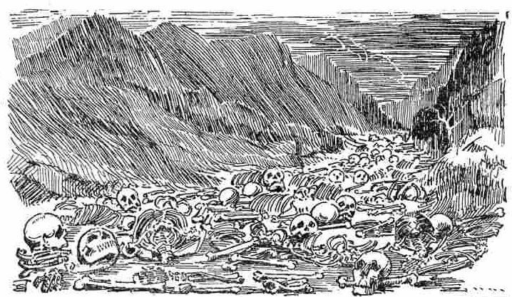
1 The hand of the LORD came upon me and brought me out in the Spirit of the LORD, and set me down in the midst of the valley; and it was full of bones.

Slide 3
2 Then He caused me to pass by them all around, and behold, there were very many in the open valley; and indeed they were very dry.

Slide 4
3 And He said to me, "Son of man, can these bones live?" So I answered, "O Lord GOD, You know."

Slide 5
4 Again He said to me, "Prophesy to these bones, and say to them, 'O dry bones, hear the word of the LORD!

Slide 6
5 Thus says the Lord GOD to these bones: "Surely I will cause breath to enter into you, and you shall live.

Slide 7
6 I will put sinews on you and bring flesh upon you, cover you with skin and put breath in you; and you shall live. Then you shall know that I am the LORD." ' "

Slide 8
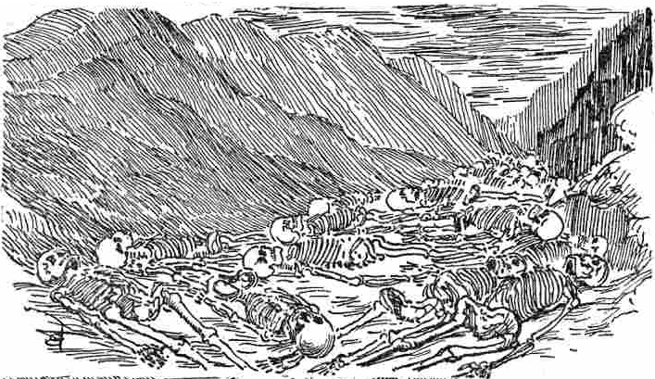
7 So I prophesied as I was commanded; and as I prophesied, there was a noise, and suddenly a rattling; and the bones came together, bone to bone.

Slide 9
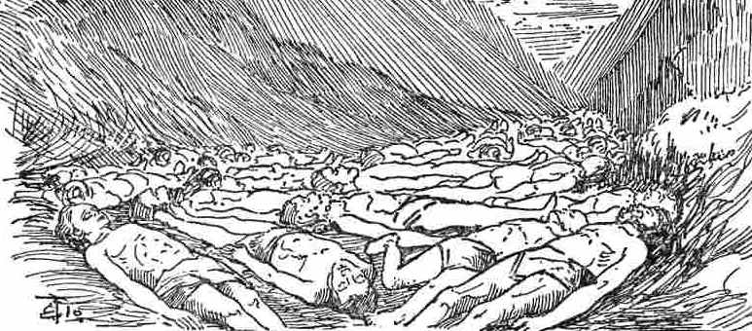
8 Indeed, as I looked, the sinews and the flesh came upon them, and the skin covered them over; but there was no breath in them.

Slide 10
9 Also He said to me, “Prophesy to the breath, prophesy, son of man, and say to the breath, ‘Thus says the Lord GOD: “Come from the four winds, O breath, and breathe on these slain, that they may live.”’”

Slide 11
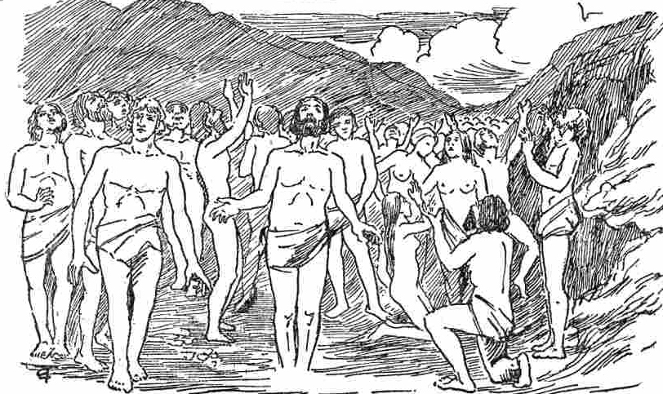
10 So I prophesied as He commanded me, and breath came into them, and they lived, and stood upon their feet, an exceedingly great army.

Slide 12
Who are these dry bones?
Ezekiel 37:11-14
Then He said to me, "Son of man, these bones are the whole house of Israel. They indeed say, 'Our bones are dry, our hope is lost, and we ourselves are cut off!'
"Therefore prophesy and say to them, 'Thus says the Lord GOD: "Behold, O My people, I will open your graves and cause you to come up from your graves, and bring you into the land of Israel.

Slide 13
Who are these dry bones?
Ezekiel 37:11-14
Then you shall know that I am the LORD, when I have opened your graves, O My people, and brought you up from your graves.
I will put My Spirit in you, and you shall live, and I will place you in your own land. Then you shall know that I, the LORD, have spoken it and performed it," says the LORD.' "

Slide 14
When was Israel cut off from their land?
Foreign Empires that ruled in Israel
587 BC
Babylonian
Destruction of the first Temple.
538-333 BC
Persian
Return of the exiled Jews from Babylon and construction of the second Temple (520-515 BC).

Slide 15
When was Israel cut off from their land?
Foreign Empires that ruled in Israel
333-63 BC
Hellenistic
Conquest of the region by the army of Alexander the Great (333 BC). The Greeks generally allowed the Jews to run their state. But, during the rule of the king Antiochus IV, the Temple was desecrated. This brought about the revolt of the Maccabees, who established an independent rule. The related events are celebrated during the Hanukah holiday.

Slide 16
When was Israel cut off from their land?
Foreign Empires that ruled in Israel
63 BC-313 AD
Roman
The Roman army led by Titus conquered Jerusalem and destroyed the Second Temple at 70 AD. Jewish people were then exiled and dispersed to the Diaspora. In 132 AD, Bar Kokhba organized a revolt against Roman rule, but was killed in a battle in Bethar in Judean Hills. Subsequently the Romans decimated the Jewish community, renamed Jerusalem as Aelia Capitolina and Judea as Palaestina to obliterate Jewish identification with the Land of Israel (the word Palestine, and the Arabic word Filastin originate from this Latin name).

Slide 17
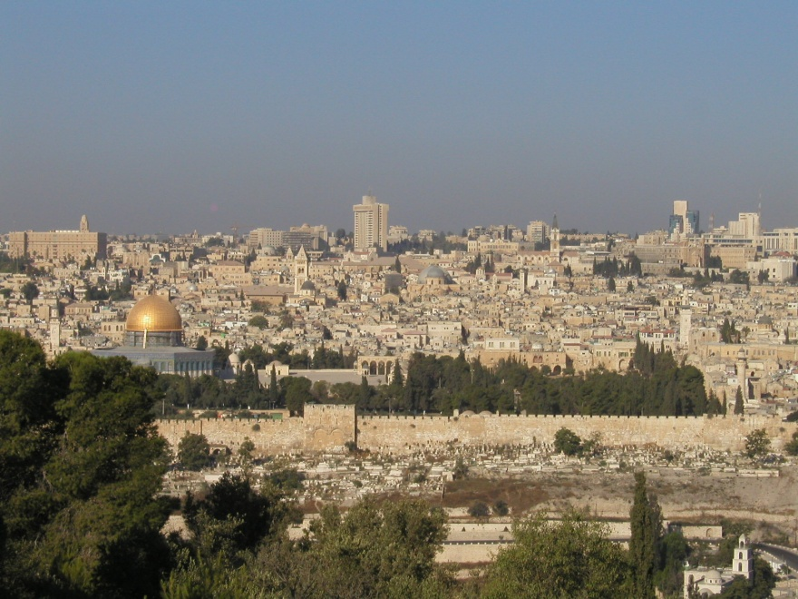
When was Israel cut off from their land?
Foreign Empires that ruled in Israel
313-636
Byzantine
636-1099
Arab
Dome of the Rock was built by Caliph Abd el-Malik on the grounds of the destroyed Jewish Temple.

Slide 18
When was Israel cut off from their land?
Foreign Empires that ruled in Israel
1099-1291
Crusaders
The crusaders came from Europe to capture the Holy Land following an appeal by Pope Urban II, and massacred the non-Christian population. Later Jewish community in Jerusalem expanded by immigration of Jews from Europe.

Slide 19
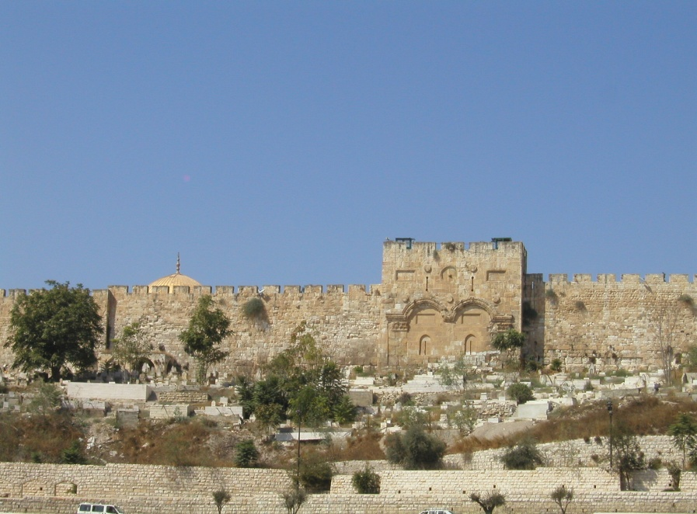
When was Israel cut off from their land?
Foreign Empires that ruled in Israel
1291-1516
Mamluk
1516-1918
Ottoman
During the reign of Sultan Suleiman the Magnificent (1520-1566) the walls of the Old City of Jerusalem were rebuilt. Population of the Jewish community in Jerusalem increased.

Slide 20
When was Israel cut off from their land?
1917-1948
British
Great Britain recognized the rights of the Jewish people to establish a "national home in Palestine". Yet they greatly curtailed entry of Jewish refugees into Israel even after World War II. They split Palestine mandate into an Arab state which has become the modern day Jordan, and Israel.

Slide 21
When was the land of Israel returned to Israel?
In 1948, Jewish Community in Israel under the leadership of David Ben-Gurion re-established sovereignty over their ancient homeland. Declaration of independence of the modern State of Israel was announced on the day that the last British forces left Israel (May 14, 1948).

Slide 22
Arab-Israeli wars
A day after the declaration of independence of the State of Israel, armies of five Arab countries, Egypt, Syria, Transjordan, Lebanon and Iraq, invaded Israel.
This marked the beginning of the War of Independence.

Slide 23
Arab-Israeli wars
Arab states have jointly waged four full scale wars against Israel:
1948 - War of Independence
1956 - Sinai War
1967 - Six Day War
1973 - Yom Kippur War

Slide 24
Arab-Israeli wars
Despite the numerical superiority of the Arab armies, Israel defended itself each time and won.
After each war, Israeli army withdrew from most of the areas it captured.
This is unprecedented in world history and shows Israel's willingness to reach peace even at the risk of fighting for its very existence each time anew.

Slide 25
Arab-Israeli wars
Note that with Judea and Samaria Israel is only 40 miles wide.
Thus, Israel can be crossed from the Mediterranean coast to the Eastern border at Jordan river within one hour of driving.

Slide 26
An Everlasting Covenant
Genesis 17:6-8
I will make you exceedingly fruitful; and I will make nations of you, and kings shall come from you.
And I will establish My covenant between Me and you and your descendants after you in their generations, for an everlasting covenant, to be God to you and your descendants after you.
Also I give to you and your descendants after you the land in which you are a stranger, all the land of Canaan, as an everlasting possession; and I will be their God."

Slide 27
The New Covenant In OT
Jeremiah 31:31-33
"Behold, the days are coming, says the LORD, when I will make a new covenant with the house of Israel and with the house of Judah–
not according to the covenant that I made with their fathers in the day that I took them by the hand to lead them out of the land of Egypt, My covenant which they broke, though I was a husband to them, says the LORD.
But this is the covenant that I will make with the house of Israel after those days, says the LORD: I will put My law in their minds, and write it on their hearts; and I will be their God, and they shall be My people.

Slide 28
The New Covenant In NT
Hebrews 8:8-10
Because finding fault with them, He says: "Behold, the days are coming, says the LORD, when I will make a new covenant with the house of Israel and with the house of Judah–
not according to the covenant that I made with their fathers in the day when I took them by the hand to lead them out of the land of Egypt; because they did not continue in My covenant, and I disregarded them, says the LORD.
For this is the covenant that I will make with the house of Israel after those days, says the LORD: I will put My laws in their mind and write them on their hearts; and I will be their God, and they shall be My people.

Slide 29
God Kept His Covenants
Jeremiah 33:20-22
"Thus says the LORD: 'If you can break My covenant with the day and My covenant with the night, so that there will not be day and night in their season, then My covenant may also be broken with David My servant, so that he shall not have a son to reign on his throne, and with the Levites, the priests, My ministers. As the host of heaven cannot be numbered, nor the sand of the sea measured, so will I multiply the descendants of David My servant and the Levites who minister to Me.' "

Slide 30
God Kept His Covenants
Both the Old & The New Covenants.
Whatever He promises, He delivers.
Whatever He started, He will complete.
When He said that the dry bones will be resurrected, they will be resurrected.
No matter whether it would take 1 day or 1000 years or 2000 years or 3000 years and so on.
It will be done in His perfect timing.

Slide 31
The Dry Bones Live!
Jeremiah 31:8-14
Behold, I will bring them from the north country, and gather them from the ends of the earth, among them the blind and the lame, the woman with child and the one who labors with child, together; a great throng shall return there.
They shall come with weeping, and with supplications I will lead them. I will cause them to walk by the rivers of waters, in a straight way in which they shall not stumble; for I am a Father to Israel, and Ephraim is My firstborn.

Slide 32
The Dry Bones Live!
Jeremiah 31:8-14
"Hear the word of the LORD, O nations, and declare it in the isles afar off, and say, 'He who scattered Israel will gather him, and keep him as a shepherd does his flock.'
For the LORD has redeemed Jacob, and ransomed him from the hand of one stronger than he.

Slide 33
The Dry Bones Live!
Jeremiah 31:8-14
Therefore they shall come and sing in the height of Zion, streaming to the goodness of the LORD-- for wheat and new wine and oil, for the young of the flock and the herd; their souls shall be like a well-watered garden, and they shall sorrow no more at all.
"Then shall the virgin rejoice in the dance, and the young men and the old, together; for I will turn their mourning to joy, will comfort them, and make them rejoice rather than sorrow.

Slide 34
The Dry Bones Live!
Jeremiah 31:8-14
I will satiate the soul of the priests with abundance, and My people shall be satisfied with My goodness, says the LORD."

Slide 35
What next?
Ezekiel 36:24-28
For I will take you from among the nations, gather you out of all countries, and bring you into your own land.
Then I will sprinkle clean water on you, and you shall be clean; I will cleanse you from all your filthiness and from all your idols.
I will give you a new heart and put a new spirit within you; I will take the heart of stone out of your flesh and give you a heart of flesh.

Slide 36
What next?
Ezekiel 36:24-28
I will put My Spirit within you and cause you to walk in My statutes, and you will keep My judgments and do them.
Then you shall dwell in the land that I gave to your fathers; you shall be My people, and I will be your God.

Slide 37
What next?
Romans 11:25-27
For I do not desire, brethren, that you should be ignorant of this mystery, lest you should be wise in your own opinion, that blindness in part has happened to Israel until the fullness of the Gentiles has come in.
And so all Israel will be saved, as it is written: "The Deliverer will come out of Zion, and He will turn away ungodliness from Jacob;
For this is My covenant with them, when I take away their sins."

Slide 38
God Is Longsuffering
2 Peter 3:8-9
But, beloved, do not forget this one thing, that with the Lord one day is as a thousand years, and a thousand years as one day.
The Lord is not slack concerning His promise, as some count slackness, but is longsuffering toward us, not willing that any should perish but that all should come to repentance.
This promise is for both the Jews and the Gentiles.
If the Jews have hope, we too have hope.

Slide 39
In Just One Day
Isaiah 66:7-9
"Before she was in labor, she gave birth; Before her pain came, she delivered a male child.
Who has heard such a thing? Who has seen such things? Shall the earth be made to give birth in one day? Or shall a nation be born at once? For as soon as Zion was in labor, she gave birth to her children.
Shall I bring to the time of birth, and not cause delivery?" says the LORD. "Shall I who cause delivery shut up the womb?" says your God.

Slide 40
Do we believe?
1 Corinthians 15:12-23
Now if Christ is preached that He has been raised from the dead, how do some among you say that there is no resurrection of the dead?
But if there is no resurrection of the dead, then Christ is not risen.
And if Christ is not risen, then our preaching is empty and your faith is also empty.
Yes, and we are found false witnesses of God, because we have testified of God that He raised up Christ, whom He did not raise up--if in fact the dead do not rise.

Slide 41
Do we believe?
1 Corinthians 15:12-23
For if the dead do not rise, then Christ is not risen.
And if Christ is not risen, your faith is futile; you are still in your sins!
Then also those who have fallen asleep in Christ have perished.
If in this life only we have hope in Christ, we are of all men the most pitiable.
But now Christ is risen from the dead, and has become the firstfruits of those who have fallen asleep.

Slide 42
Do we believe?
1 Corinthians 15:12-23
For since by man came death, by Man also came the resurrection of the dead.
For as in Adam all die, even so in Christ all shall be made alive. (Note: ALL)
But each one in his own order: Christ the firstfruits, afterward those who are Christ's at His coming.

Slide 43
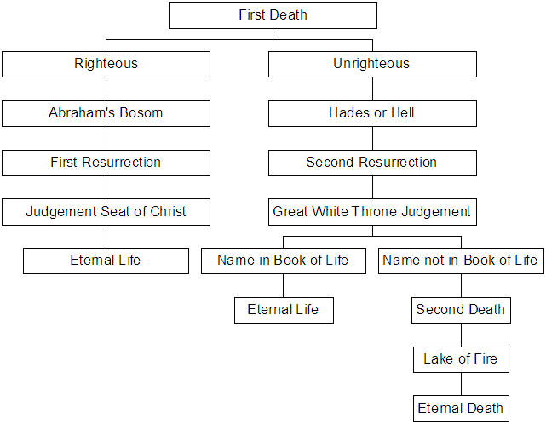
A Possible Chart According To Rev 20

