Slide 1
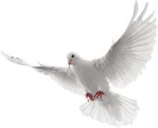
The 2 Pentecosts
Revisiting Mount Sinai & Mount Zion
by Joshua Ong

Slide 2
Even Before the Public Release of The Law at Mount Sinai
God spoke to men.
Among the various issues communicated are His commandments.
Abraham knew His commandments about 500 years prior to their first public release to Israel at Mount Sinai. (Gen 26:5)
Because that Abraham obeyed my voice, and kept my charge, my commandments, my statutes, and my laws.

Slide 3
The Biblical Covenants
God made covenants and kept them.
Edenic (Gen 1:26-28; 2:15-17)
Adamic (Gen 3:14-19)
Noahic (Gen 8:21-9:17, 24-27)
Abrahamic (Gen 12:1-3)
Mosaic (Exo 19:5-8)
Land (Deu 28:63-68; 30:1-9)
Davidic (2 Sam 7:12-16)
New (Jer 31:31-34; Heb 8:6-13)

Slide 4
Looking At The Covenants

Slide 5
Hermeneutic Remainders
Scriptures cannot contradict scriptures.
All scriptures must be seen in the light of their context.
God never changes. (Mal 3:6; Heb 13:8; James 1:17)

Slide 6
The New Covenant
The English title “New” is quite misleading.
In both, Hebrew and Greek, it also means “renewed”.
For example, the term “new moon” means a renewed appearance of the moon rather than a brand-new creation.
“One covenant does not set aside another; one does not invalidate another so as to nullify its stipulations. Rather, it renews, expands, adapts, updates.” Dr. John Fischer
More correctly, the New Covenant should be called “The Renewed Covenant.”

Slide 7
What’s In the New Covenant?
In The Old Testament: Jeremiah 31:31-34
"Behold, the days are coming, says the LORD, when I will make a new covenant with the house of Israel and with the house of Judah--not according to the covenant that I made with their fathers in the day that I took them by the hand to lead them out of the land of Egypt, My covenant which they broke, though I was a husband to them, says the LORD. But this is the covenant that I will make with the house of Israel after those days, says the LORD: I will put My law in their minds, and write it on their hearts; and I will be their God, and they shall be My people. No more shall every man teach his neighbor, and every man his brother, saying, 'Know the LORD,' for they all shall know Me, from the least of them to the greatest of them, says the LORD. For I will forgive their iniquity, and their sin I will remember no more."

Slide 8
What’s In the New Covenant?
In The New Testament: Hebrews 8:8-10
Because finding fault with them, He says: "Behold, the days are coming, says the LORD, when I will make a new covenant with the house of Israel and with the house of Judah--not according to the covenant that I made with their fathers in the day when I took them by the hand to lead them out of the land of Egypt; because they did not continue in My covenant, and I disregarded them, says the LORD. For this is the covenant that I will make with the house of Israel after those days, says the LORD: I will put My laws in their mind and write them on their hearts; and I will be their God, and they shall be My people. None of them shall teach his neighbor, and none his brother, saying, 'Know the LORD,' for all shall know Me, from the least of them to the greatest of them. For I will be merciful to their unrighteousness, and their sins and their lawless deeds I will remember no more."

Slide 9
What’s In the New Covenant?

Slide 10
Original Intention
God’s original intention is to write the laws on hearts rather than tablets of stone. (Deut 6:1-6)
"Now this is the commandment, and these are the statutes and judgments which the LORD your God has commanded to teach you, that you may observe them in the land which you are crossing over to possess, that you may fear the LORD your God, to keep all His statutes and His commandments which I command you, you and your son and your grandson, all the days of your life, and that your days may be prolonged. Therefore hear, O Israel, and be careful to observe it, that it may be well with you, and that you may multiply greatly as the LORD God of your fathers has promised you--' a land flowing with milk and honey.’ Hear, O Israel: The LORD our God, the LORD is one! You shall love the LORD your God with all your heart, with all your soul, and with all your strength. And these words which I command you today shall be in your heart.”

Slide 11
What Actually Happened in Mount Sinai?
Very briefly, God wanted to share with the whole nation of Israel PERSONALLY His terms and conditions of living in the Promised Land.
But the Israelites stood afar off, while Moses drew near to where God was (Exodus 20:21).

Slide 12
In Leviticus 23, seven feasts are outlined.
They are called the Feasts of the LORD.
Passover |  | Pentecost |  | Tabernacles
Salvation |  | Sanctification |  | Glorification
Egypt |  | Wilderness |  | Promised Land

Slide 13
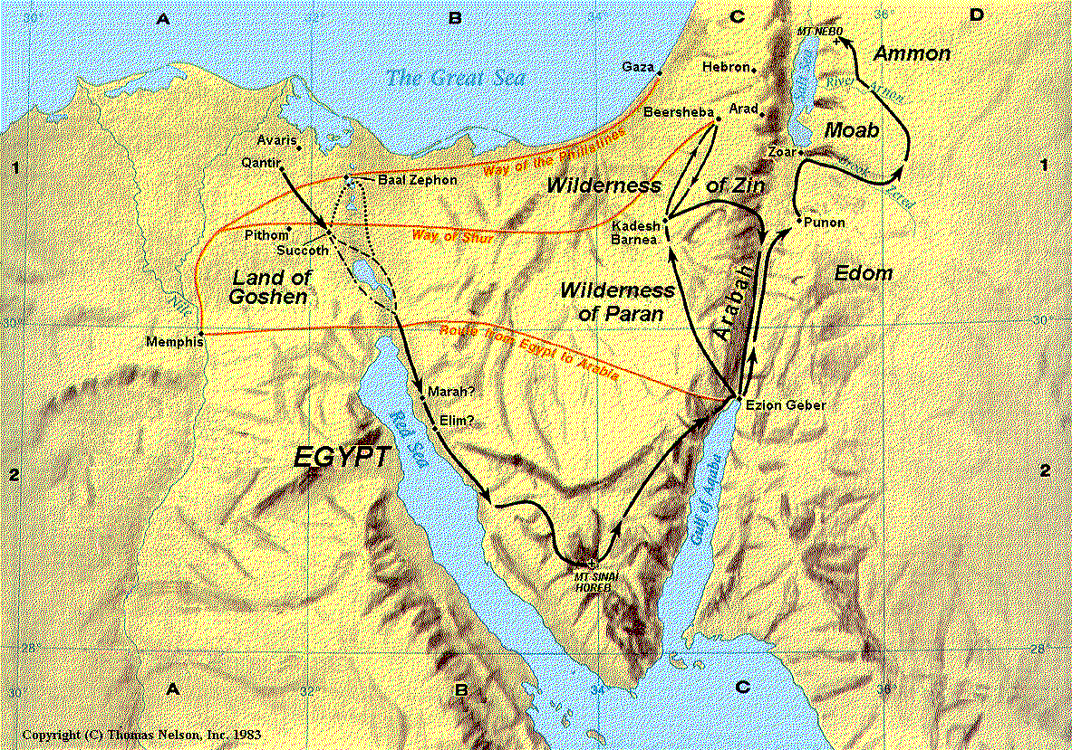
From Egypt To Mount Sinai
In Goshen:
On the night of Passover, each household slaughtered a lamb without blemish (Exo 12:5-6).

Slide 14
From Egypt To Mount Sinai
Blood of the lamb was struck on the doorposts (Exo 12:7).

Slide 15
From Egypt To Mount Sinai
When the LORD saw the blood, He will pass over that household; otherwise the firstborn in that household would die (Exo 12:12-13).

Slide 16
From Egypt To Mount Sinai
That night, The LORD smote all the firstborn of Egypt (Exo 12:29).

Slide 17
From Egypt To Mount Sinai
Pharaoh called for Moses and Aaron by night, and released the Israelites (Exo 12:31-32).

Slide 18
From Egypt To Mount Sinai
The Egyptians gave everything the Israelites requested - articles of gold and silver, and clothings (Exo 12:35-36).

Slide 19
From Egypt To Mount Sinai
The Israelites departed from Rameses and journeyed unto Succoth. They baked unleavened bread as they went out of Egypt (Exo 12:37-39).

Slide 20
From Egypt To Mount Sinai
The LORD shared with Moses about the ordinance and observance of the Passover (Exo 12:43-13:16).

Slide 21
From Egypt To Mount Sinai
The Israelites took their journey from Succoth to Etham (Exo 13:20).

Slide 22
From Egypt To Mount Sinai
The LORD went before them by day in a pillar of cloud, to lead them in the way; and by night in a pillar of fire, to give them light (Exo 13:20-22).

Slide 23
From Egypt To Mount Sinai
The LORD spoke to Moses to turn and encamp by the sea over against Baalzephon (Exo 14:1-2).

Slide 24
From Egypt To Mount Sinai
The Egyptians pursued after the Israelites encamping before Baalzephon (Exo 14:9).

Slide 25
From Egypt To Mount Sinai
The Israelites were sore afraid of the impending Egyptians and complained to Moses (Exo 14:10-12).

Slide 26
From Egypt To Mount Sinai
Moses said to Israel, “Fear not, stand still and see the salvation of the LORD.” Exo 14:13

Slide 27
From Egypt To Mount Sinai
The pillar of the cloud came between the camp of Egyptians and the camp of Israel (Exo 14:19-20).

Slide 28
From Egypt To Mount Sinai
Moses stretched out his hand over the Red Sea, and it parted. The Israelites went into the sea upon dry ground (Exo 14:21-22).

Slide 29
From Egypt To Mount Sinai
The Egyptians pursued, and were buried in the sea (Exo 14:23-31).

Slide 30
From Egypt To Mount Sinai
Moses and the children of Israel sang a song of victory (Exo 15:1-19).

Slide 31
From Egypt To Mount Sinai
They went into the wilderness of Shur for 3 days, and found no water (Exo 15:22).

Slide 32
From Egypt To Mount Sinai
They came to Marah where the waters were bitter, and they murmured. God showed Moses a tree. Upon casting it upon the waters, they turned sweet (Exo 15:23-26).

Slide 33
From Egypt To Mount Sinai
At Marah, God revealed Himself as “I am the LORD that healeth thee.” (Exo 15:26).

Slide 34
From Egypt To Mount Sinai
They came to Elim wherein were 12 wells and 70 palm trees. They encamped there by the waters (Exo 15:27).

Slide 35
From Egypt To Mount Sinai
They journeyed through the Wilderness of Sin, and murmured because of hunger (Exo 16:1-3).

Slide 36
From Egypt To Mount Sinai
God gave them heavenly manna and its gathering instructions (Exo 16:11-31).

Slide 37
From Egypt To Mount Sinai
They came to Rephidim, and found no water. Israel murmured again (Exo 17:1-3).

Slide 38
From Egypt To Mount Sinai
God instructed Moses to strike a rock, and water came out of it (Exo 17:6-7).

Slide 39
From Egypt To Mount Sinai
At Rephidim, the Amalekites attacked Israel. Moses interceded while Joshua fought (Exo 17:8-10).

Slide 40
From Egypt To Mount Sinai
Israel won when Moses’ hands were lifted up. Moses built an altar “The-LORD-Is-My-Banner” (Exo 17:11-16).

Slide 41
From Egypt To Mount Sinai
Moses’ Father-in-law, Jethro came to visit him, and gave him counsel about solving people’s problems. (Exo 18:1-18).

Slide 42
From Egypt To Mount Sinai
Moses appointed judges over 1000, 100, 50 and 10 respectively as advised by Jethro (Exo 18:19-27).

Slide 43
From Egypt To Mount Sinai
Israel came to the Wilderness of Sinai in the third month after going out of Egypt (Exo 19:1-2).

Slide 44
Leviticus 23:15-16
And you shall count for yourselves from the day after the Sabbath, from the day that you brought the sheaf of the wave offering: seven Sabbaths shall be completed.
Count fifty days to the day after the seventh Sabbath; then you shall offer a new grain offering to the LORD.
The Feast of Pentecost will always be the day after the seventh Sabbath. It will always begin on the evening of a Saturday.

Slide 45
The First Pentecost: 50th Day After Crossing the Red Sea

Slide 46
What Actually Happened on the First Pentecost at Mount Sinai?
Moses went up to God.
Mount
Sinai
Israelites

Slide 47
The LORD said to him, “Thus you shall say to the house of Jacob, and tell the children of Israel: 'You have seen what I did to the Egyptians, and how I bore you on eagles' wings and brought you to Myself. Now therefore, if you will indeed obey My voice and keep My covenant, then you shall be a special treasure to Me above all people; for all the earth is Mine. And you shall be to Me a kingdom of priests and a holy nation.' These are the words which you shall speak to the children of Israel.” Exodus 19:3-6
Mount
Sinai
Israelites

Slide 48
So Moses came and called for the elders of the people, and laid before them all these words which the LORD commanded him. Then all the people answered together and said, "All that the LORD has spoken we will do." Exodus 19:7-8
Mount
Sinai
Israelites

Slide 49
So Moses brought back the words of the people to the LORD.
And the LORD said to Moses, "Behold, I come to you in the thick cloud, that the people may hear when I speak with you, and believe you forever.”
So Moses told the words of the people to the LORD. Exo 19:8-9
Mount
Sinai
Israelites

Slide 50
Then the LORD said to Moses, "Go to the people and consecrate them today and tomorrow, and let them wash their clothes. And let them be ready for the third day. For on the third day the LORD will come down upon Mount Sinai in the sight of all the people. You shall set bounds for the people all around, saying, 'Take heed to yourselves that you do not go up to the mountain or touch its base. Whoever touches the mountain shall surely be put to death. Not a hand shall touch him, but he shall surely be stoned or shot with an arrow; whether man or beast, he shall not live.' When the trumpet sounds long, they shall come near the mountain.” Exo 19:10-13
Mount
Sinai
Israelites

Slide 51
So Moses went down from the mountain to the people and sanctified the people, and they washed their clothes.
And he said to the people, "Be ready for the third day; do not come near your wives." Exo 19:14-15
Mount
Sinai
Israelites

Slide 52
Then it came to pass on the third day, in the morning, that there were thunderings and lightnings, and a thick cloud on the mountain; and the sound of the trumpet was very loud, so that all the people who were in the camp trembled.
And Moses brought the people out of the camp to meet with God, and they stood at the foot of the mountain.
Exo 19:16-17
Mount
Sinai
Israelites

Slide 53
Now Mount Sinai was completely in smoke, because the LORD descended upon it in fire. Its smoke ascended like the smoke of a furnace, and the whole mountain quaked greatly. And when the blast of the trumpet sounded long and became louder and louder, Moses spoke, and God answered him by voice.
Then the LORD came down upon Mount Sinai, on the top of the mountain. Exo 19:18-20
Mount
Sinai
Israelites

Slide 54
And the LORD called Moses to the top of the mountain, and Moses went up.
And the LORD said to Moses, "Go down and warn the people, lest they break through to gaze at the LORD, and many of them perish. Also let the priests who come near the LORD consecrate themselves, lest the LORD break out against them.” Exo 19:20-22
Mount
Sinai
Israelites

Slide 55
But Moses said to the LORD, "The people cannot come up to Mount Sinai; for You warned us, saying, 'Set bounds around the mountain and consecrate it.' "
Then the LORD said to him, "Away! Get down and then come up, you and Aaron with you. But do not let the priests and the people break through to come up to the LORD, lest He break out against them." Exo 19:23-24
Mount
Sinai
Israelites

Slide 56
So Moses went down to the people and spoke to them. Exo 19:25
Mount
Sinai
Israelites

Slide 57
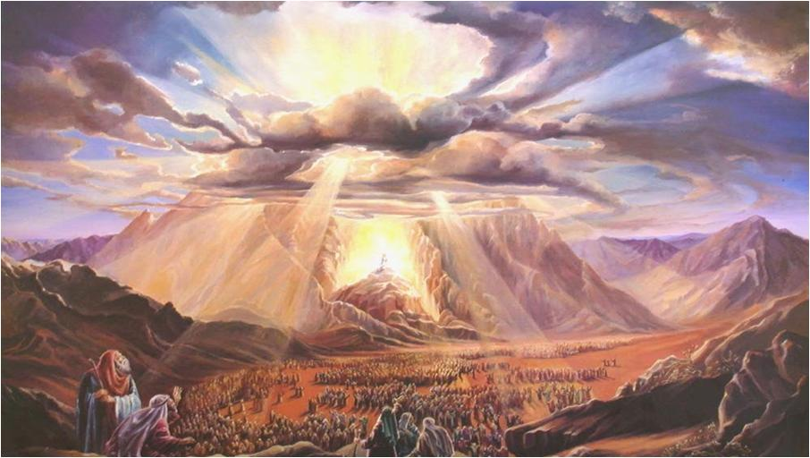
When every instruction is being given, and everyone settled down, the LORD spoke and gave the Israelites the Ten Commandments (Exodus 20:1-17).

Slide 58
BUT when they witnessed the thunderings, the lightning flashes, the sound of the trumpet, and the mountain smoking; and when the people saw it, they trembled and stood afar off. (Exo 20:18)
Then they said to Moses, "You speak with us, and we will hear; but let not God speak with us, lest we die.” (Exodus 20:19)

Slide 59
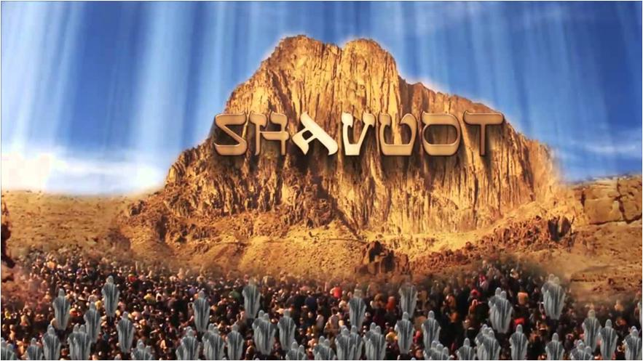
They heard the voice of God as He gave them the Ten Commandments!

Slide 60
And Moses said to the people, "Do not fear; for God has come to test you, and that His fear may be before you, so that you may not sin.” (Exo 20:20)
So the people stood afar off, but Moses drew near the thick darkness where God was. (Exo 20:21)
God then spoke to Moses warnings against idolatry and also instructions about building an altar for Him. (Exo 20:22-25)
In Exodus 21, 22 & 23, God gave Moses the civil laws pertaining to treatment of servants, responsibility for property and keeping His feasts. He also promised to send an Angel to lead them.

Slide 61
God wants to meet with the Elders.
Now He said to Moses, "Come up to the LORD, you and Aaron, Nadab and Abihu, and seventy of the elders of Israel, and worship from afar.
"And Moses alone shall come near the LORD, but they shall not come near; nor shall the people go up with him."
So Moses came and told the people all the words of the LORD and all the judgments. And all the people answered with one voice and said, "All the words which the LORD has said we will do.” Exodus 24:1-3

Slide 62
An Altar, 12 Pillars and The Book of The Covenant
And Moses wrote all the words of the LORD. And he rose early in the morning, and built an altar at the foot of the mountain, and twelve pillars according to the twelve tribes of Israel. Then he sent young men of the children of Israel, who offered burnt offerings and sacrificed peace offerings of oxen to the LORD.
And Moses took half the blood and put it in basins, and half the blood he sprinkled on the altar. Then he took the Book of the Covenant and read in the hearing of the people. And they said, "All that the LORD has said we will do, and be obedient."
And Moses took the blood, sprinkled it on the people, and said, "This is the blood of the covenant which the LORD has made with you according to all these words.” Exo 24:4-8

Slide 63
The Elders Saw God, Ate And Drank In His Presence.
Then Moses went up, also Aaron, Nadab, and Abihu, and seventy of the elders of Israel, and they saw the God of Israel. And there was under His feet as it were a paved work of sapphire stone, and it was like the very heavens in its clarity.
But on the nobles of the children of Israel He did not lay His hand. So they saw God, and they ate and drank. Exo 24:9-11

Slide 64
About The Tablets Of Stone
Then the LORD said to Moses, "Come up to Me on the mountain and be there; and I will give you tablets of stone, and the law and commandments which I have written, that you may teach them.”
So Moses arose with his assistant Joshua, and Moses went up to the mountain of God.
And he asked the elders to wait there for them.
Then Moses went up into the mountain, and a cloud covered the mountain.
So Moses went into the midst of the cloud and went up into the mountain. And Moses was on the mountain forty days and forty nights. (Exo 24:13-18)

Slide 65
From Exodus 25 through 31, God revealed how the ark of covenant and the tabernacle were to be built, how the priests were to dress, how sacrifices were made, and how the Sabbath was to be kept.
In Exo 31:16-17, He said, “Therefore the children of Israel shall keep the Sabbath, to observe the Sabbath throughout their generations as a perpetual covenant. It is a sign between Me and the children of Israel forever; for in six days the LORD made the heavens and the earth, and on the seventh day He rested and was refreshed.'"
And when He had made an end of speaking with him on Mount Sinai, He gave Moses two tablets of the Testimony, tablets of stone, written with the finger of God (Exo 31:18).

Slide 66
The Golden Calf
Meanwhile, the people saw that Moses delayed coming down from the mountain, they rebelled and built the golden calf (Exo 32:1-6).
God was furious, and sent Moses down from the mountain with the two stone tablets (Exo 32:7-15).
Moses asked the people to choose which side they would take.
3000 men were killed on this first Pentecost! (Exo 32:28).

Slide 67
Moses Reminded The People In Deut 9:9-11:
"When I went up into the mountain to receive the tablets of stone, the tablets of the covenant which the LORD made with you, then I stayed on the mountain forty days and forty nights. I neither ate bread nor drank water. Then the LORD delivered to me two tablets of stone written with the finger of God, and on them were all the words which the LORD had spoken to you on the mountain from the midst of the fire in the day of the assembly. And it came to pass, at the end of forty days and forty nights, that the LORD gave me the two tablets of stone, the tablets of the covenant.”

Slide 68
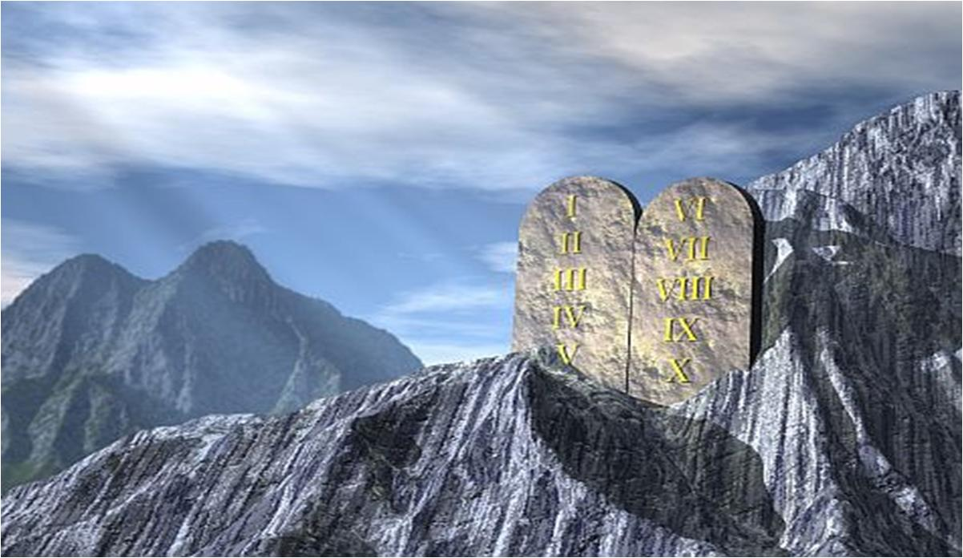
The LORD gave Moses the two tablets of stone at the end and NOT the beginning of forty days and forty nights.

Slide 69
Jewish History Records The Meeting At Sinai
Rabbi Joseph Hertz's Dailey Prayer Book (pg. 791)
"The Revelation at Sinai… was not heard by Israel alone, but by the inhabitants of all the earth. The Divine voice divided itself into the seventy tongues then spoken on the earth, so that all the children of men might understand its world-embracing and man-redeeming message."
Midrash: Exodus Rabbah 5:9
"When God gave the Torah on Sinai, He displayed untold marvels to Israel with His voice. What happened? God spoke and the Voice reverberated throughout the world… It says, 'And all the people witnessed the thunderings (Ex. 20:18).

Slide 70
Note that it does not say "the thunder," but "the thunderings"; wherefore, Rabbi Johanan said that God's voice, as it was uttered, split up into seventy voices, in seventy languages, so that all the nations should understand." The Midrash Says, R. Moshe Weissman,
Venei Yakov Publications (1980) pg. 182.
"On the occasion of matan Torah (the giving of the torah), the Bnai Yisrael (the children of Israel) not only heard Hashem's (the Lord's) Voice, but actually saw the sound waves as they emerged from Hashem's (the Lord's) mouth. They visualized them as a fiery substance. Each commandment that left Hashem's (the Lord's) mouth traveled around the entire Camp and then came back to every Jew individually, asking him, "Do you accept upon yourself this commandment with all halachot (Jewish law) pertaining to it?"

Slide 71
From Mount Sinai To Jerusalem (Mount Zion)
A. Same Path of Salvation
1. Must be saved by the blood of the Passover Lamb
2. Must receive the First Fruit of the Spirit
B. New Covenant Pentecost (Acts 2:1-21)
1. Same manifestations as at the first Pentecost (v. 1-11)
2. Still those who refuse to hear (v. 12-13)
3. Sons and daughters prophesy (v. 14-18)
4. Warning of judgment (Vs. 19-21)
C. Every nation under heaven heard the utterance in his own language. (Acts 2:5-6).
D. 3000 souls were saved that day (Acts 2:41).

Slide 72
What Jesus Spoke About The Holy Spirit...
What is the primary work of the Holy Spirit?
"But the Helper, the Holy Spirit, whom the Father will send in My name, He will teach you all things, and bring to your remembrance all things that I said to you.” John 14:26
What did Jesus say prior to this verse?
"He who has My commandments and keeps them, it is he who loves Me. And he who loves Me will be loved by My Father, and I will love him and manifest Myself to him... If anyone loves Me, he will keep My word; and My Father will love him, and We will come to him and make Our home with him. He does not love Me does not keep My words; and the word which you hear is not Mine but the Father's who sent Me. These things I have spoken to you while being present with you.” John 14:21-25

Slide 73
What did Jesus say about the Law of the LORD?
"Do not think that I came to destroy the Law or the Prophets. I did not come to destroy but to fulfill.
"For assuredly, I say to you, till heaven and earth pass away, one jot or one tittle will by no means pass from the law till all is fulfilled.
"Whoever therefore breaks one of the least of these commandments, and teaches men so, shall be called least in the kingdom of heaven; but whoever does and teaches them, he shall be called great in the kingdom of heaven.
"For I say to you, that unless your righteousness exceeds the righteousness of the scribes and Pharisees, you will by no means enter the kingdom of heaven. Matt 5:17-20
In fact, Jesus expounded on the Ten Commandments from Matthew 5:21-7:28 after He shared the Beatitudes on the Mount.

Slide 74
What Moses said about the ministry of Jesus?
"The LORD your God will raise up for you a Prophet like me from your midst, from your brethren. Him you shall hear, according to all you desired of the LORD your God in Horeb in the day of the assembly, saying, 'Let me not hear again the voice of the LORD my God, nor let me see this great fire anymore, lest I die.'
"And the LORD said to me: 'What they have spoken is good.
'I will raise up for them a Prophet like you from among their brethren, and will put My words in His mouth, and He shall speak to them all that I command Him. And it shall be that whoever will not hear My words, which He speaks in My name, I will require it of him.’ Deut 18:15-19

Slide 75
What Peter said about Jesus’ ministry?
"Repent therefore and be converted, that your sins may be blotted out, so that times of refreshing may come from the presence of the Lord, and that He may send Jesus Christ, who was preached to you before, whom heaven must receive until the times of restoration of all things, which God has spoken by the mouth of all His holy prophets since the world began. For Moses truly said to the fathers, 'The LORD your God will raise up for you a Prophet like me from your brethren. Him you shall hear in all things, whatever He says to you. ‘And it shall be that every soul who will not hear that Prophet shall be utterly destroyed from among the people.’ "Yes, and all the prophets, from Samuel and those who follow, as many as have spoken, have also foretold these days. You are sons of the prophets, and of the covenant which God made with our fathers, saying to Abraham, 'And in your seed all the families of the earth shall be blessed.’ To you first, God, having raised up His Servant Jesus, sent Him to bless you, in turning away every one of you from your iniquities." Acts 3:19-26

Slide 76
Jesus Obeyed The Commandments
Jesus obeyed and taught the commandments, and the Holy Spirit wrote them on the disciples’ hearts on the second Pentecost reminding them of everything Jesus said.
The Law To Be Written On Tablets Of The Heart
You are our epistle written in our hearts, known and read by all men; clearly you are an epistle of Christ, ministered by us, written not with ink but by the Spirit of the living God, not on tablets of stone but on tablets of flesh, that is, of the heart. 2 Cor. 3:2-3
“I will give you a new heart and put a new spirit within you; I will take the heart of stone out of your flesh and give you a heart of flesh. I will put My Spirit within you and cause you to walk in My statutes, and you will keep My judgments and do them.” Ezek 36:26-27

Slide 77
Looking again at Matthew 6:33...
What Is Kingdom?
'Now therefore, if you will indeed obey My voice and keep My covenant, then you shall be a special treasure to Me above all people; for all the earth is Mine. And you shall be to Me a kingdom of priests and a holy nation.' Exo 19:5-6
What Is Righteousness?
'And the LORD commanded us to observe all these statutes, to fear the LORD our God, for our good always, that He might preserve us alive, as it is this day. Then it will be righteousness for us, if we are careful to observe all these commandments before the LORD our God, as He has commanded us.' Deut 6:24-25

Slide 78
A Comparison Of The 2 Pentecosts

Slide 79
Celebrating The Feast of Pentecost...
Paul celebrated Pentecost because that commandment was written on his heart. Acts 20:16
"For Paul had decided to sail past Ephesus in order that he might not have to spend time in Asia; for he was hurrying to be in Jerusalem, if possible, on the day of Pentecost."

Slide 80
God is still speaking to our hearts today...
A. Church Has Come To Mount Zion (Heb. 12:18-24)
City of God the Heavenly Jerusalem
Church of the first born
B. God Is Currently Warning From Heaven (Heb. 12:22-29)
Don't refuse His warning
Consuming Fire of Pentecost Spirit
C. Do Not Harden Your Hearts (Heb. 3:7-8, 15-19)

Slide 81
Jesus is the same, yesterday, today and forever. (Heb 13:8)
His laws are the same, no shadows of turning.
But the response to His laws can change, whether we harden our hearts against them and become lawless and disobedient; or we soften our hearts towards them, and become lawful and obedient and enter into His rest.
Therefore, as the Holy Spirit says: "Today, if you will hear His voice, do not harden your hearts as in the rebellion, in the day of trial in the wilderness, where your fathers tested Me, tried Me, and saw My works forty years. Therefore I was angry with that generation, and said, 'They always go astray in their heart, and they have not known My ways.' So I swore in My wrath, 'They shall not enter My rest.' ” Heb 3:7-11

Slide 82
The Law & World Missions
"And I will make your descendants multiply as the stars of heaven; I will give to your descendants all these lands; and in your seed all the nations of the earth shall be blessed; because Abraham obeyed My voice and kept My charge, My commandments, My statutes, and My laws." Gen 26:4-5
"Surely I have taught you statutes and judgments, just as the LORD my God commanded me, that you should act according to them in the land which you go to possess. Therefore be careful to observe them; for this is your wisdom and your understanding in the sight of the peoples who will hear all these statutes, and say, 'Surely this great nation is a wise and understanding people.’ For what great nation is there that has God so near to it, as the LORD our God is to us, for whatever reason we may call upon Him? And what great nation is there that has such statutes and righteous judgments as are in all this law which I set before you this day?” Deut 4:5-8

Slide 83
The Law & World Missions
"A new commandment I give to you, that you love one another; as I have loved you, that you also love one another. By this all will know that you are My disciples, if you have love for one another."
John 13:34-35

Slide 84
One Last Word About The Torah
The Torah is not about a way of salvation through obedience on its commandments.
Salvation is by faith through grace, through the blood of the Lamb.
The Torah is rather the Biblical instructions for those who have been redeemed by Messiah, and wanting to please the Father through righteous living according to His Word.

